Slide 1
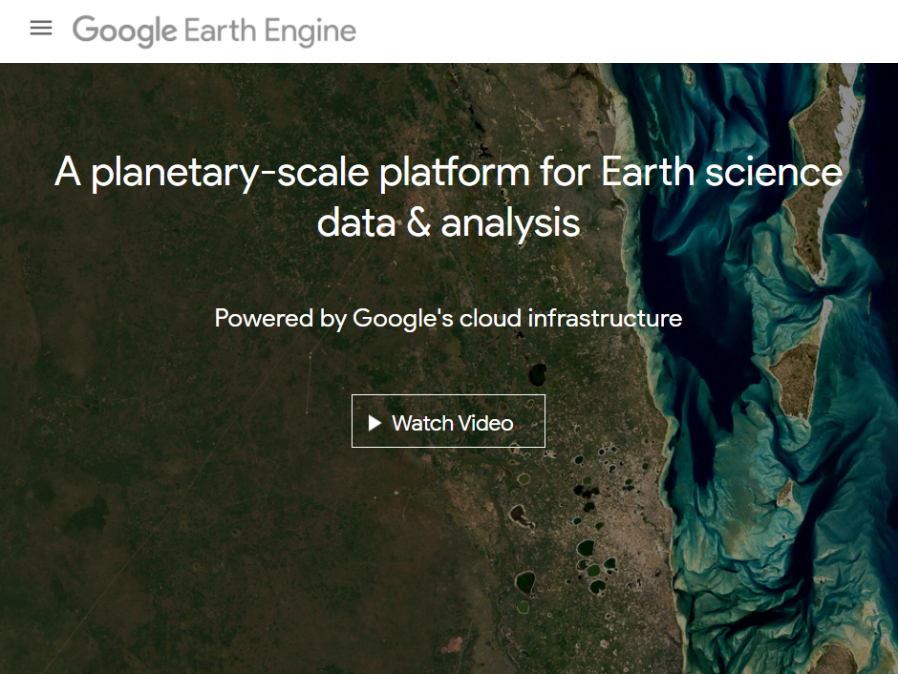
Step 1 Open an account in Google Earth Engine https://earthengine.google.com/ It is free.

Slide 2
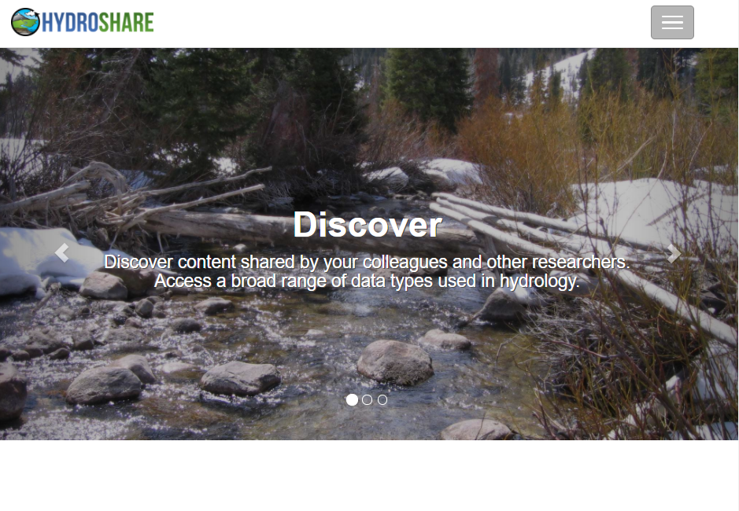
Step 2: Open an account in HydroShare https://www.hydroshare.org/ It is free.

Slide 3
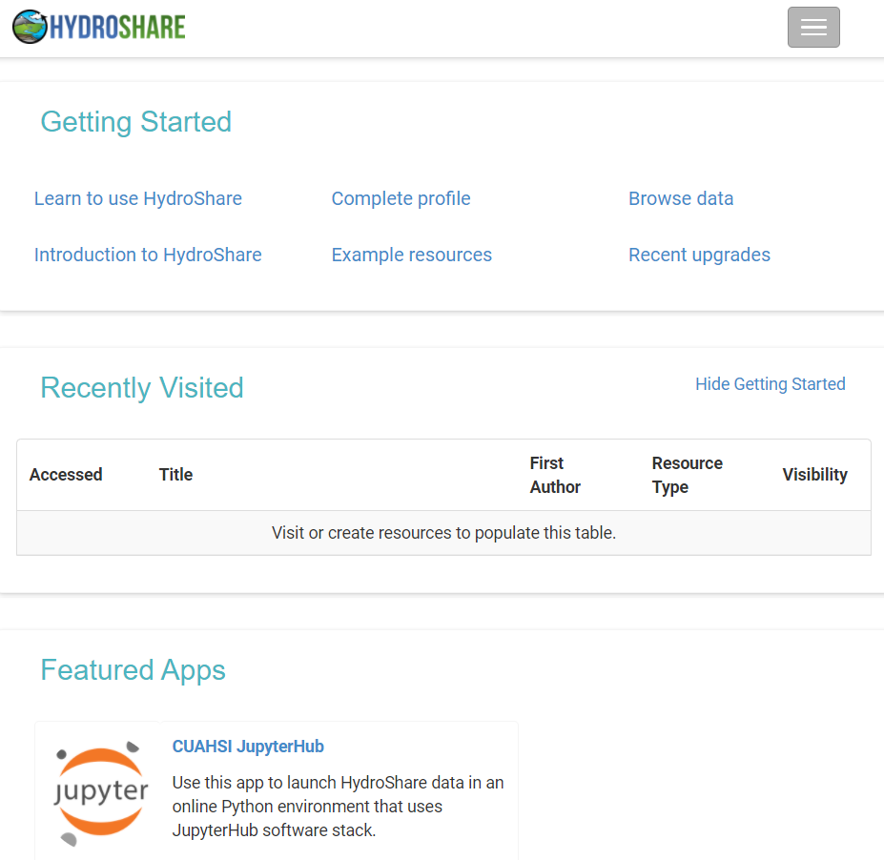
Step 3: In your Hydroshare account, select the "CUAHSI JupyterHub" app and follow instructions. In server options, select "Python 3.7 Scientific" and continue.

Slide 4
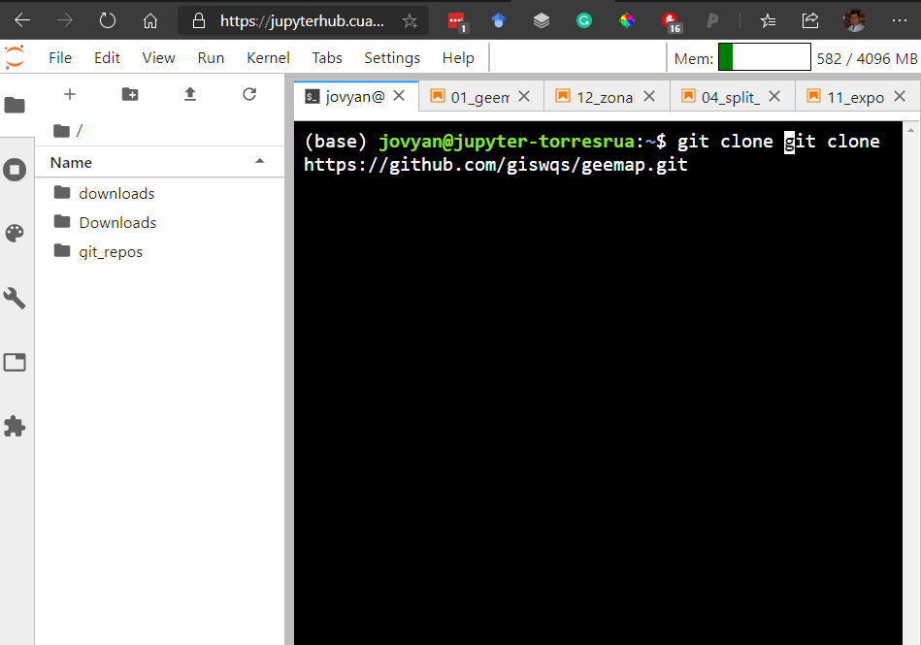
Step 4: Bring GEEMAP notebooks to JupyterHub by running this command in the terminal: git clone https://github.com/giswqs/geemap.git

Slide 5
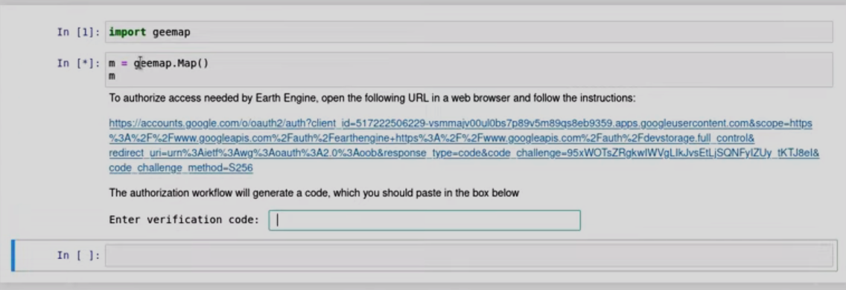
Step 5 (only done once): In a new notebook, enter in two cells: import geemap m = geemap.Map() m run cells, follow the link, and enter verification code

Slide 6
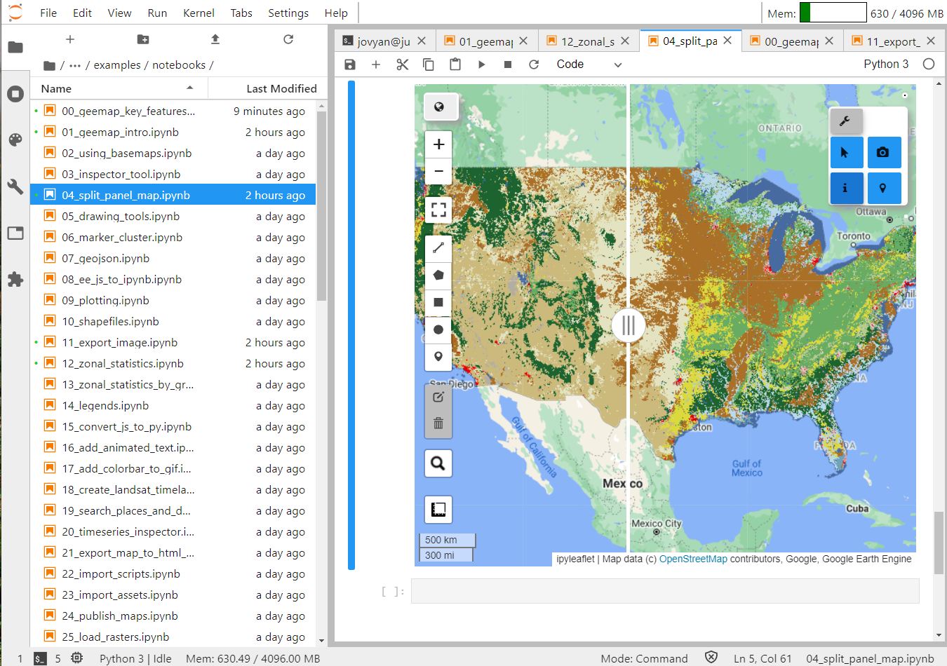
Now you can run GEEMAP notebooks in HydroShare Enjoy!

